Slide 1
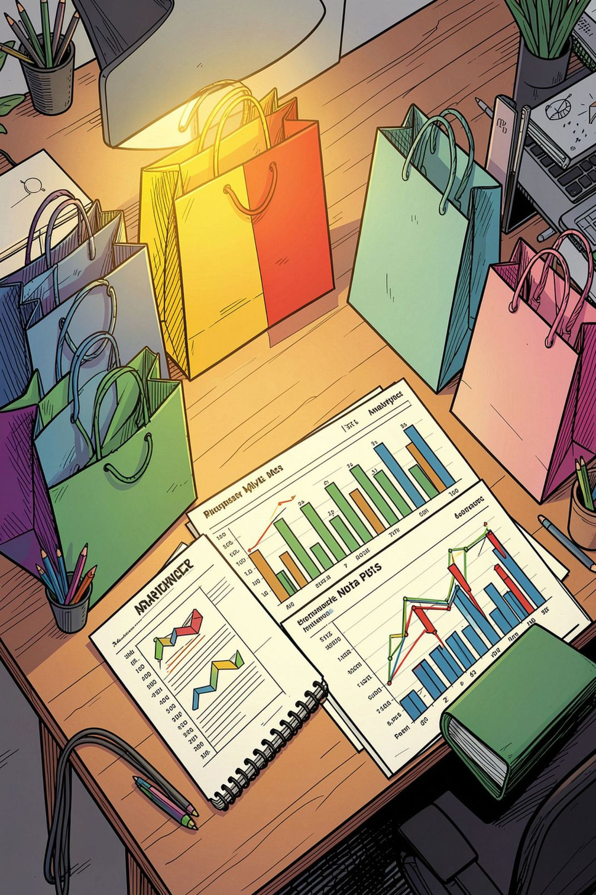
Customer Shopping Behavior Analysis
Uncovering spending patterns, customer segments, and product preferences from 3,900 transactions across multiple categories.
Notes:
1

Slide 2
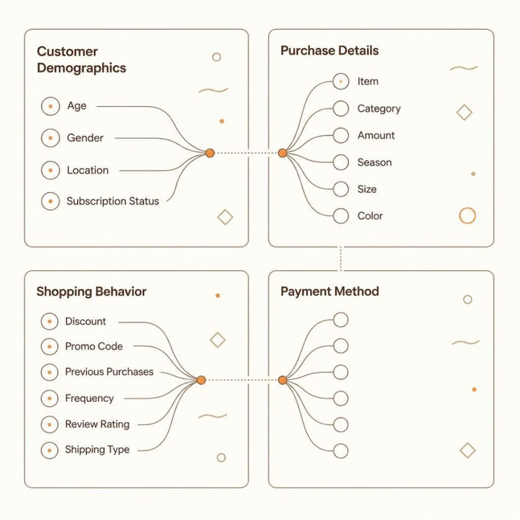
Dataset at a Glance
3,900
18
Transactions
Features
37
$59.76
Missing Values
Avg Purchase
Review Rating column
Key Feature Groups
Demographics — Age, Gender, Location, Subscription
Purchase Details — Item, Category, Amount, Season
Behavior — Discount, Frequency, Review Rating
Notes:
2

Slide 3



Data Preparation in Python
01
Load & Explore
pandas — df.info(), describe()
02
Clean Missing Data
Imputed Review Rating by category median
03
Feature Engineering
Created age_group and purchase_frequency_days
04
Database Integration
Loaded cleaned DataFrame into PostgreSQL
Notes:
3

Slide 4
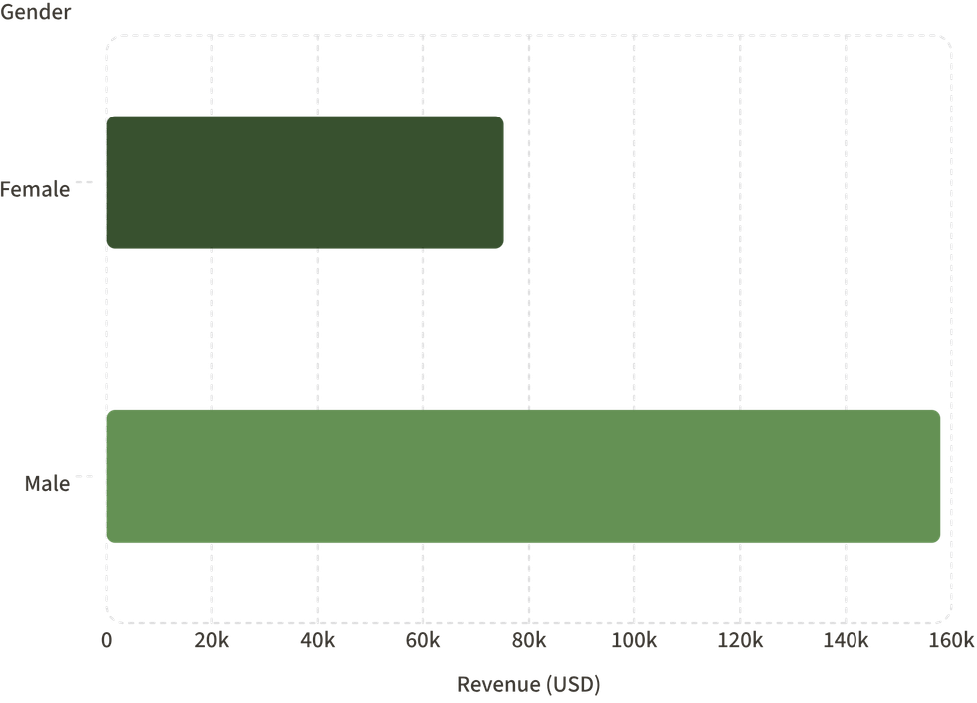

Revenue by Gender
Key Finding
Male customers generated 2.1× more revenue than female customers.
Male: $157,890 · Female: $75,191
Notes:
4

Slide 5
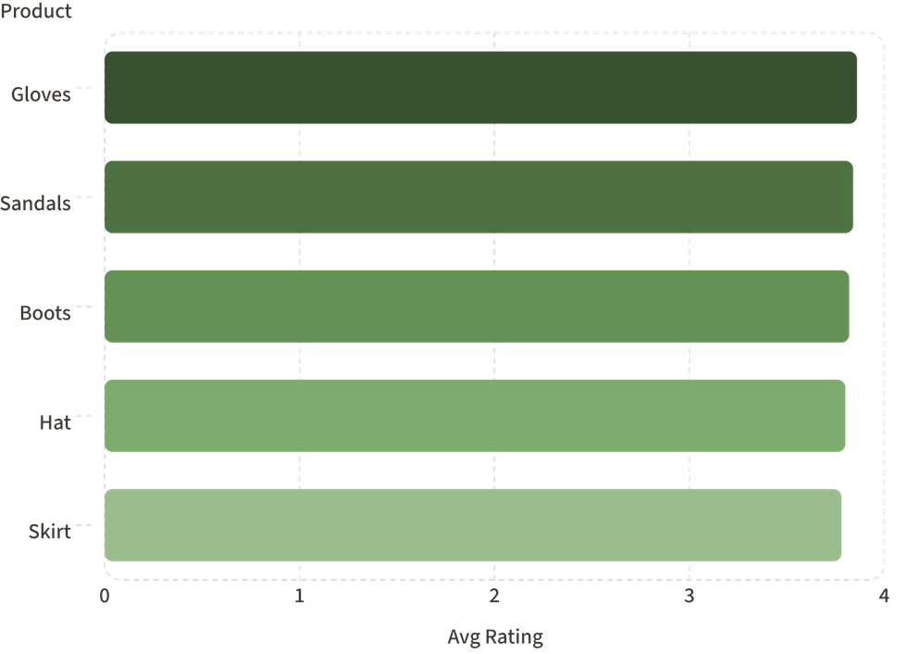
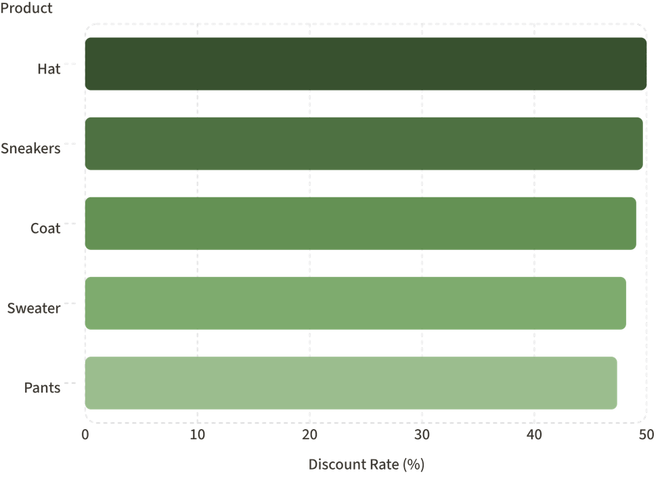
Top Products & Discount Patterns
Top 5 by Review Rating
Most Discount-Dependent Products
Notes:
5

Slide 6

Shipping & Subscription Insights
Shipping Type
Express: $60.48 avg vs. Standard: $58.46
Subscription Status
Subscribers: 1,053 · Avg spend: $59.49
Non-subscribers: 2,847 · Avg spend: $59.87
Subscribers spend nearly the same — opportunity to grow base.
Notes:
6

Slide 7
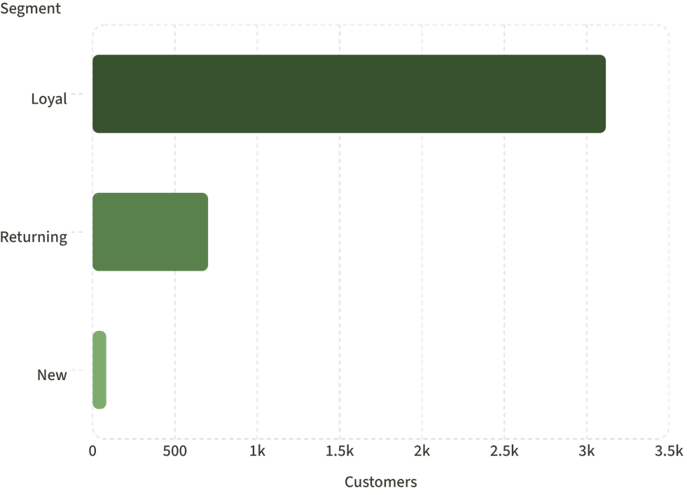
Customer Segmentation
Segment Breakdown
Loyal
Returning
3,116 customers
701 customers
New
83 customers
Customers with >5 purchases: 958 subscribed vs. 2,518 not subscribed.
Notes:
7

Slide 8
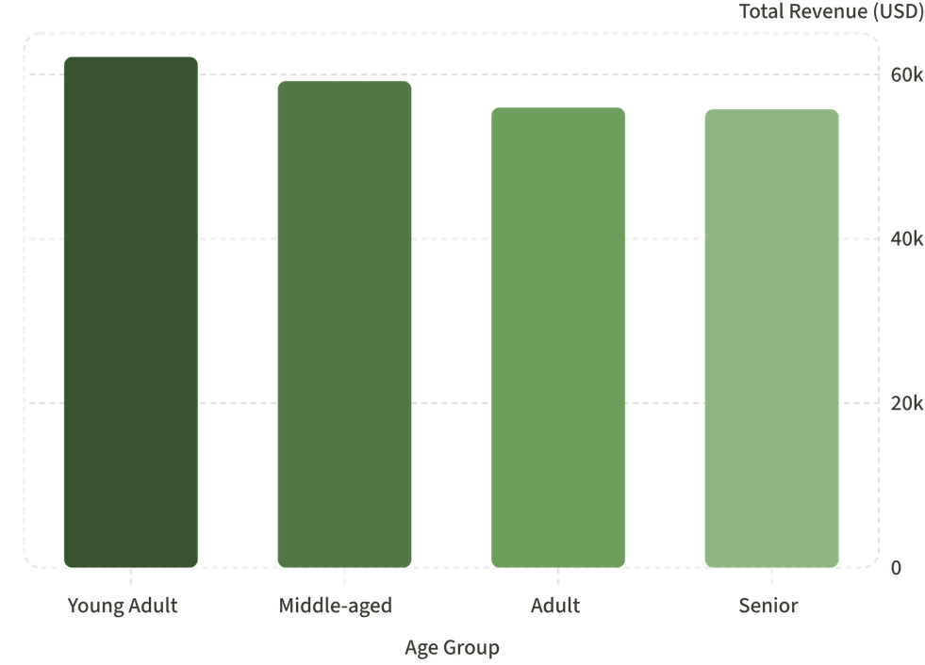
Revenue by Age Group
Key Insight
Young Adults lead in revenue at $62,143, but all groups contribute relatively evenly — no single age group dominates.
Revenue spread is surprisingly balanced across all four age segments.
Notes:
8

Slide 9
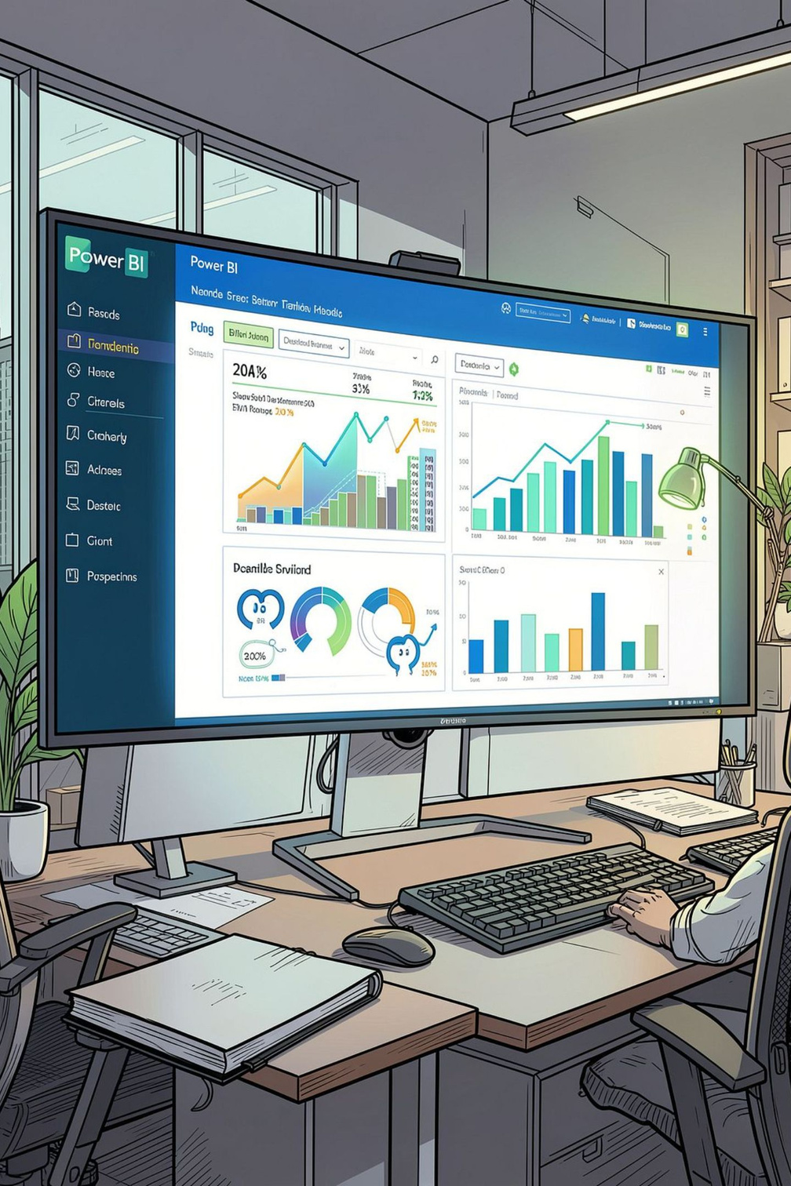
Power BI Dashboard
3.9K Customers
Total transaction records
$59.76 Avg
Average purchase amount
3.75 Rating
Average review score
27% Subscribers
Subscription penetration
Interactive filters: Subscription Status · Gender · Category · Shipping Type
Notes:
9

Slide 10





Business Recommendations
Boost Subscriptions
Promote exclusive subscriber benefits
Loyalty Programs
Reward repeat buyers → Loyal segment
Review Discount Policy
Balance sales lift with margin control
Targeted Marketing
Focus on high-revenue age groups & express-shipping users
Notes:
10

